Slide 1
Timestamp Ordering
Timestamp ordering is a non-locking method to ensure serializable transactions by assigning unique timestamps to transactions and ordering operations based on these timestamps.

Slide 2
1. Key Concepts
Timestamps: Each transaction is assigned a unique timestamp when it starts
(e.g., T1 < T2 < T3).
Read/Write Timestamps: Objects track:
  Read timestamp: Latest transaction that read the object.
  Write timestamp: Latest transaction that wrote the object.

Slide 3
1. Key Concepts
Tentative Versions: Writes create temporary versions (invisible to others) until the transaction commits.

Slide 4
2. Basic Rules
Read Rule
  A transaction T with timestamp Tc can read an object D if:
  Tc > write_timestamp(D) (ensures no dirty reads).
  If D has a tentative version from an uncommitted transaction, T waits until it commits/aborts.

Slide 5
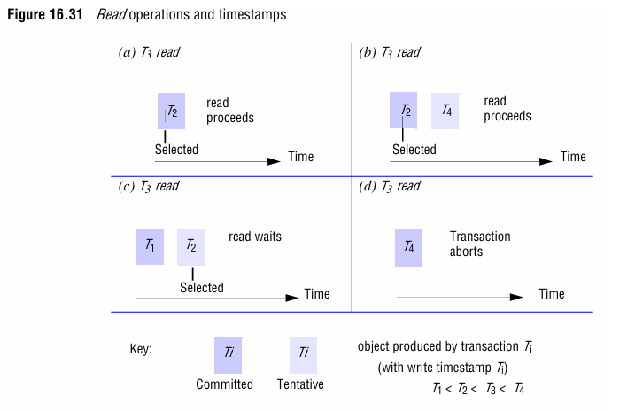
2. Basic Rules

Slide 6
2.Basic Rules
If T3 reads an object, it uses the version with the largest write timestamp ≤ T3.
If the version is tentative (e.g., from T2), T3 waits for T2 to commit/abort.

Slide 7
2.Basic Rules
b. Write Rule
  A transaction T with timestamp Tc can write an object D if:
  Tc > read_timestamp(D) (no later transaction has read D).
  Tc > write_timestamp(D) (no later transaction has written D).

Slide 8
2.Basic Rules
b. Write Rule
  A transaction T with timestamp Tc can write an object D if:
  Tc > read_timestamp(D) (no later transaction has read D).
  Tc > write_timestamp(D) (no later transaction has written D).

Slide 9
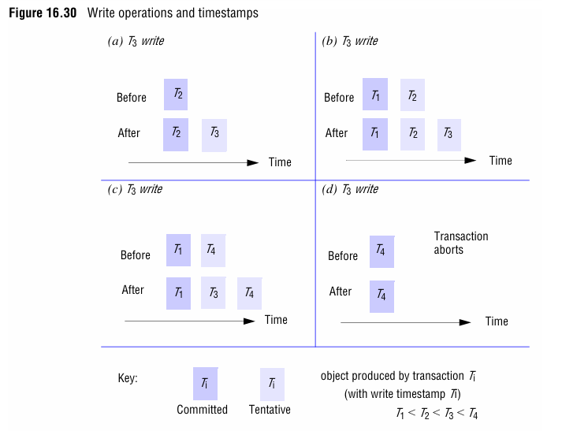
2.Basic Rules

Slide 10
2. Basic Rule
If T3 writes D, it creates a tentative version with timestamp T3.
If another transaction T4 (with T4 > T3) tries to write D, T3’s write is rejected (aborted).

Slide 11
3. Conflict Handling
Write-Read Conflict: If Tc writes after a later transaction reads, abort (Tc is too late).
Read-Write Conflict: If Tc reads after a later transaction writes, abort (Tc is too late).
Write-Write Conflict: If Tc writes after a later transaction writes, abort.

Slide 12
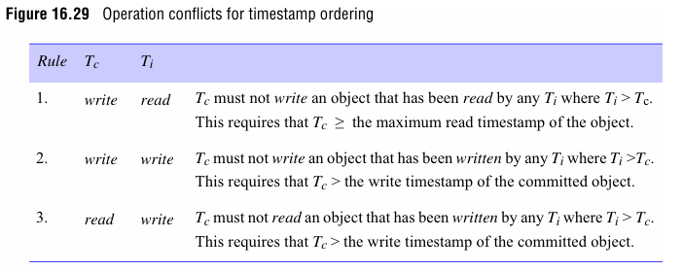
3. Conflict Handling

Slide 13
4. Multiversion Timestamp Ordering
Multiple Versions: Each write creates a new version with its timestamp.
Reads: Access the latest committed version with write_timestamp ≤ Tc.
Avoids conflicts by allowing reads to use older versions.

Slide 14
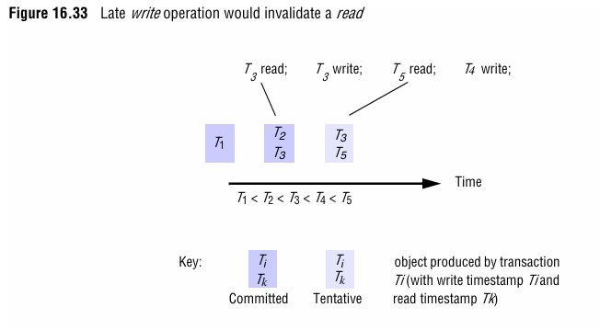
4. Multiversion Timestamp Ordering

Slide 15
4. Multiversion Timestamp Ordering
T3 reads D and gets the latest committed version (e.g., D2 with write_timestamp=T2).
If T4 writes D, it creates D4 (tentative), but T3 continues using D2.

Slide 16
5. Strict Timestamp Ordering
Delayed Operations: Transactions wait to read/write until all earlier transactions commit/abort.
Prevents Cascading Aborts: No transaction sees uncommitted data.

Slide 17
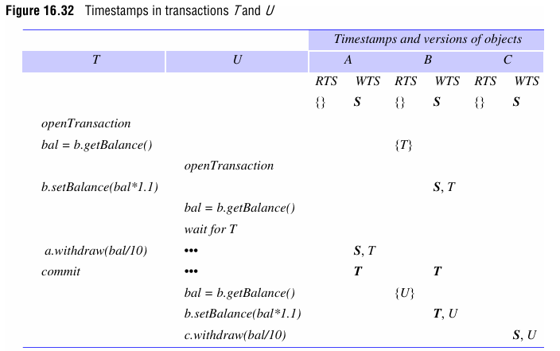
5. Strict Timestamp Ordering

Slide 18
5. Strict Timestamp Ordering
Example:
  Transaction U reads B but must wait for T to commit if T has a tentative write on B.

Slide 19
6. Example: Banking Transactions
Transactions:
  T: read(B) → write(B, 220)
  U: read(B) → write(B, 242)

Slide 20
6. Example: Banking Transactions

Slide 21
6. Example: Banking Transactions
Execution:
  T reads B (write timestamp = T1).
  U tries to read B but waits for T to commit.
  T writes B (new tentative version with timestamp T).
  T commits, making B=220 permanent (write timestamp = T).
  U reads B=220 and writes B=242 (timestamp U > T allowed).

Slide 22
7. Recovery & Durability
Logging: Timestamps and object versions are logged for crash recovery.
Commit Process: Tentative versions become permanent only after successful validation.

Slide 23
8. Advantages & Drawbacks
Advantages:
  No locks → reduced deadlocks.
  Read-only transactions proceed without blocking.
Drawbacks:
  Frequent aborts in high-contention scenarios.
  Overhead from maintaining multiple versions.

